Slide 1
POC- User Management Application
29th September 2023

Slide 2
Contents
Tech Stacks
Components
Functionality
Sequence Diagram
Learnings
Outputs

Slide 3
TechStack
Application server - JBoss 7.4​
MySQL Workbench (Version - 8.0)​
JSP (Version – 2.3)​
Servlet (Version - 3.0)​
EJB (Version - 3.10)​
JDK (Version - 1.8)​
Eclipse (Version - 4.28)​

Slide 4
Components
  JSP
  userDetails.jsp
  editUser.jsp
  Servlet
  UsersServlet
  Session Bean
  EJBUserSessionBean
  EJBUserSessionBeanLocal
  EJBUserSessionBeanRemote

Slide 5
Functionality Overview
User Management App- CRUD
  This is a User Management App focusing on CRUD operations. This has a basic functionality of managing user data in form of tables. We can add a new user, Getting all the user in the form of table, update an existing user, and delete the user completely.
  This project is built using Java and it utilizes JDBC for connecting to and interacting with the database.

Slide 6
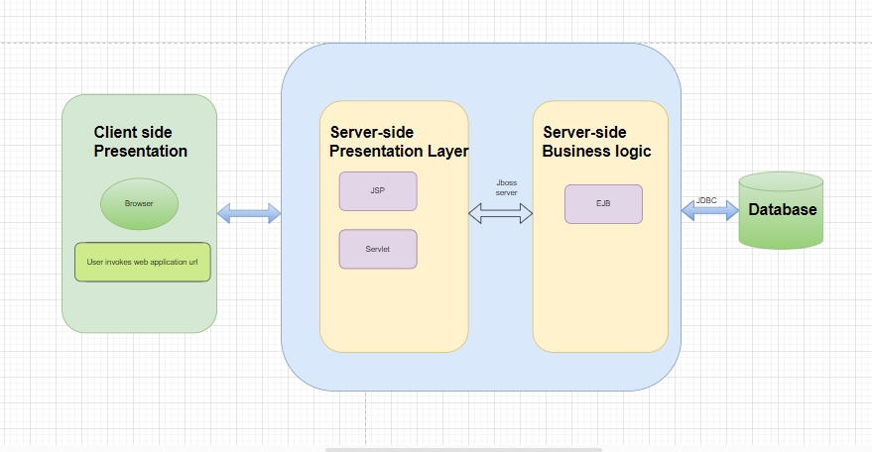
Architecture Diagram

Slide 7
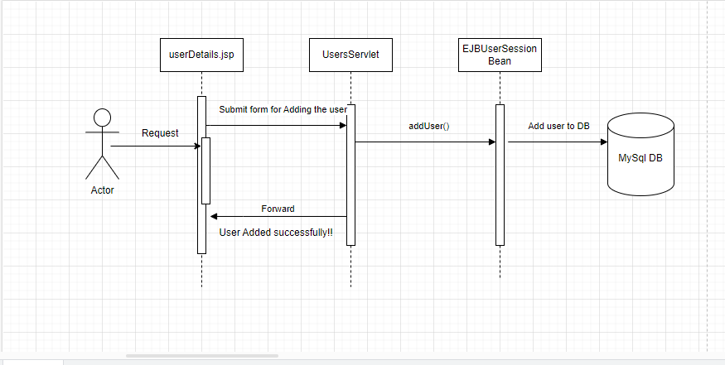
Sequence Diagram For Add User

Slide 8
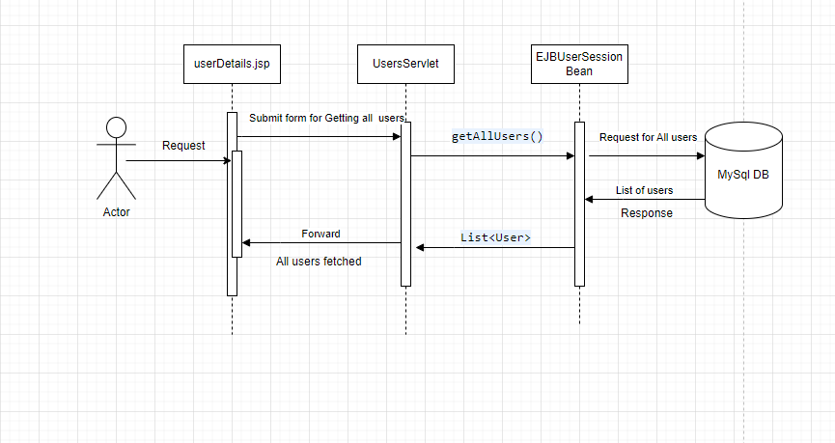
Sequence Diagram for Getting all users

Slide 9
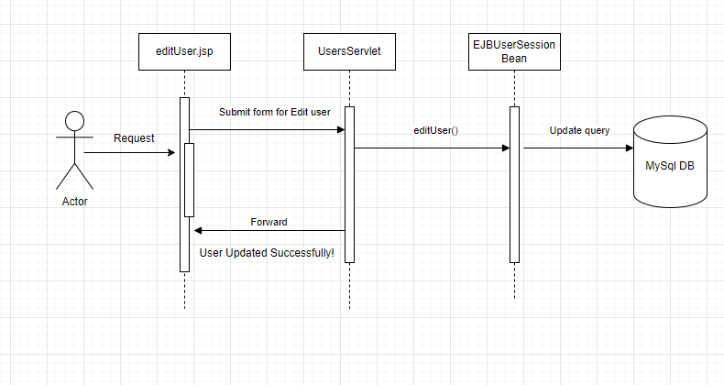
Sequence diagram for Edit User

Slide 10
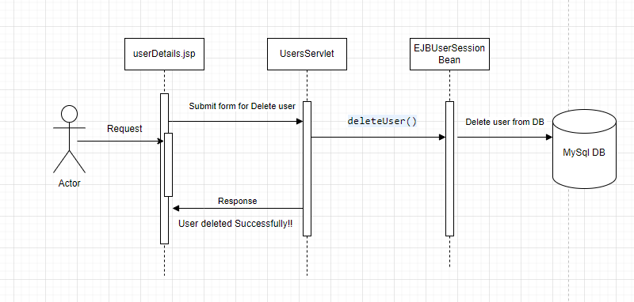
Sequence diagram for Delete User

Slide 11
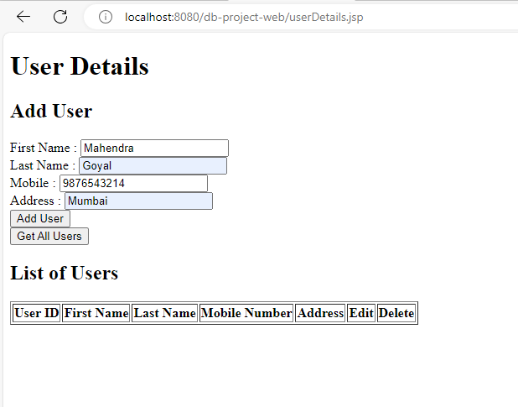
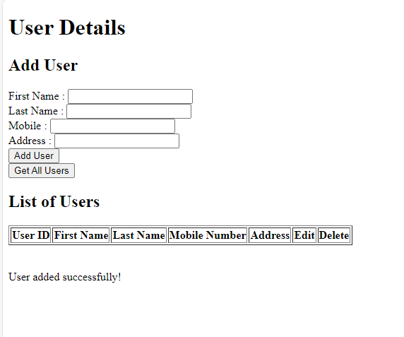
Outputs

Slide 12
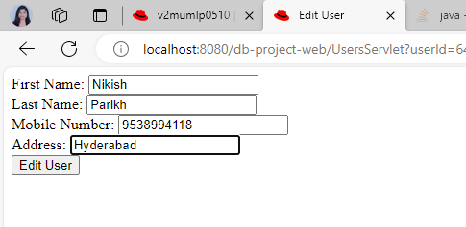
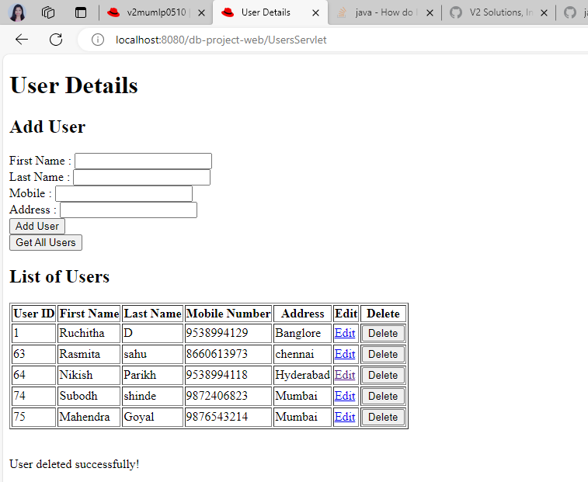
Outputs

Slide 13
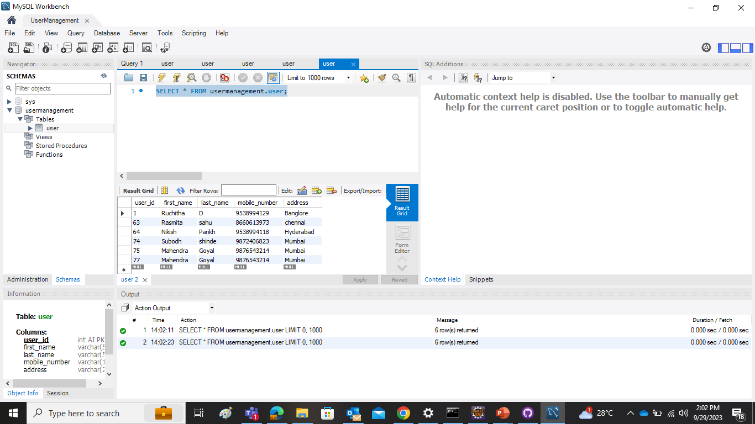
DB-output

Slide 14
Learnings
EJB Session Bean
Data source Connection
CRUD Operations
JDBC
JNDI Lookup
Servlet- Http Get and post handling
JSP & JSTL Tags
Database-MySql
Logging
Debugging
Deployment using Jboss ApplicationServer

Slide 15
Q&A

Slide 16
First Last
email@email
First Last
email@email

